Slide 1
NBA Job Salaries
Clorissa Callender
Marcus Baptiste

Slide 2
Introduction
Purpose of the Study
This study analyzes the salaries of various NBA players within the NBA league.
Dataset
This dataset was obtained from Kaggle.
Contains 13 variables, in addition to 1 response variable, which was created to identify if the salary is above or below a specified threshold value.
Dataset comprises 485 rows of data.
Dependent variable 1 is Salary.
Dependent variable 2 is Y classified High or Low based on Salary.

Slide 3
Variables
The independent variables (X) that will be used are:
Age - Age of the player
G - Number of games played
PER - Player efficiency rating
TS% - Player’s true shooting percentage
3PAr - Player’s 3 point attempt rate
FTr - Player’s free throw rate
TRB% - Player’s rebound percentage
STL% - Player’s steal percentage
BLK% - Player’s block percentage
WS% - Player’s win share percentage

Slide 4
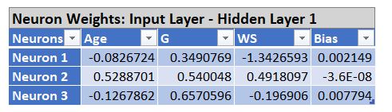
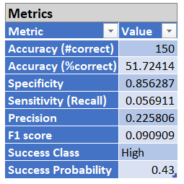
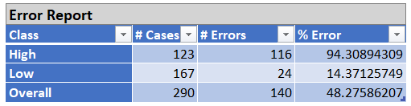
3 Neurons, 3 Regressors, 0.43 cutoff

Slide 5
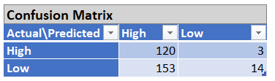
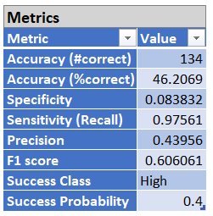
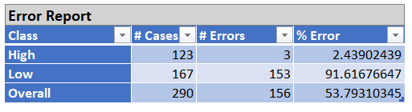
10 Neurons, 10 Regressors, 0.4 cutoff

Slide 6
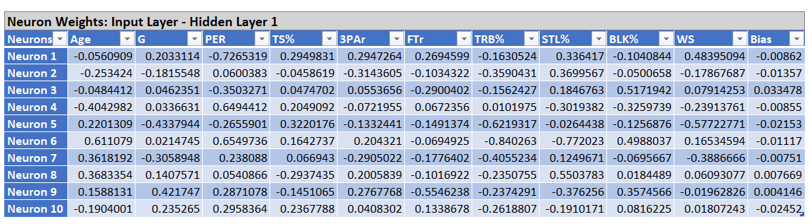
10 Neurons, 10 Regressors, 0.6 cutoff

Slide 7
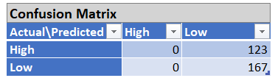
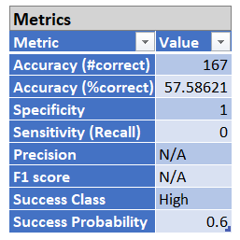
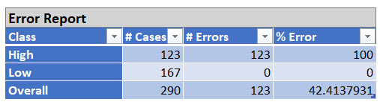
10 Neurons, 10 Regressors, 0.6 cutoff

Slide 8
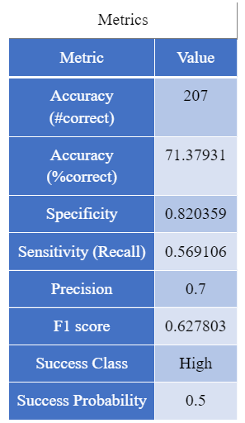
Logistic Regression Model VS Neural Network

Slide 9
Summary and Conclusion
Multiple neural networks were used to analyze this dataset
Neural network with 0.6 cutoff, 10 neurons and 10 regressors was selected
Logistic regression model wins.

